Slide 1
Schedule Builder

Slide 2
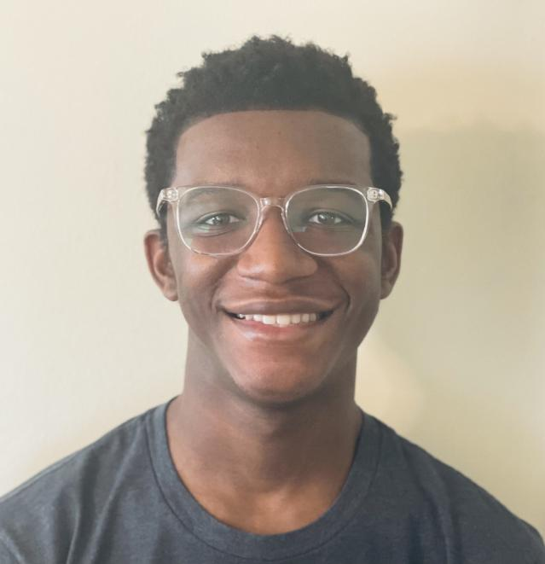
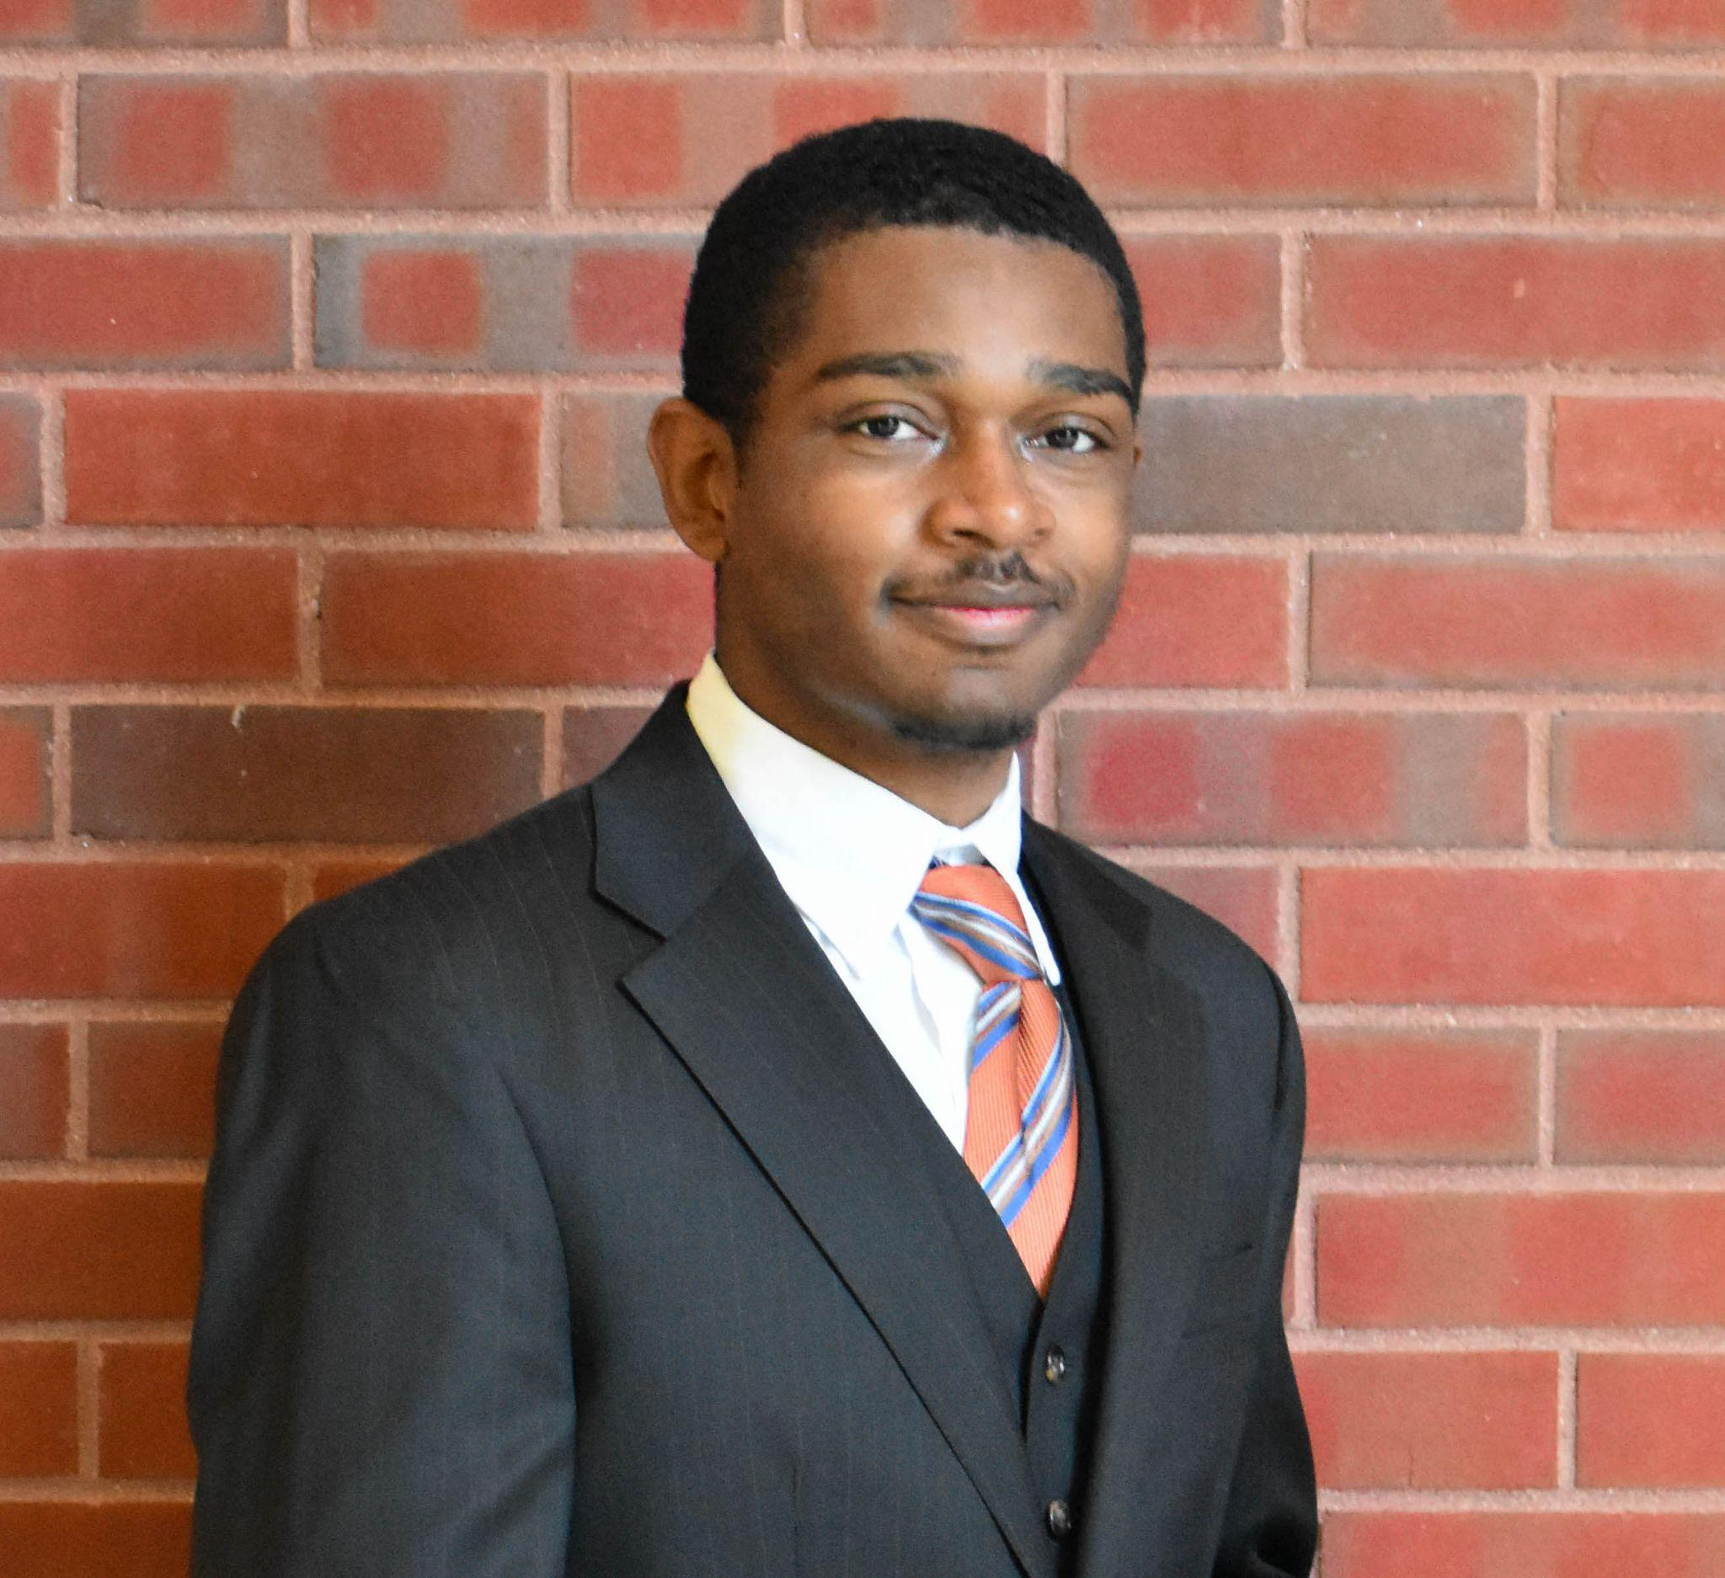
The Team
Logan Ross
Kennedy Thompson
Sydney Kadegnon
Bradon Thymes

Slide 3
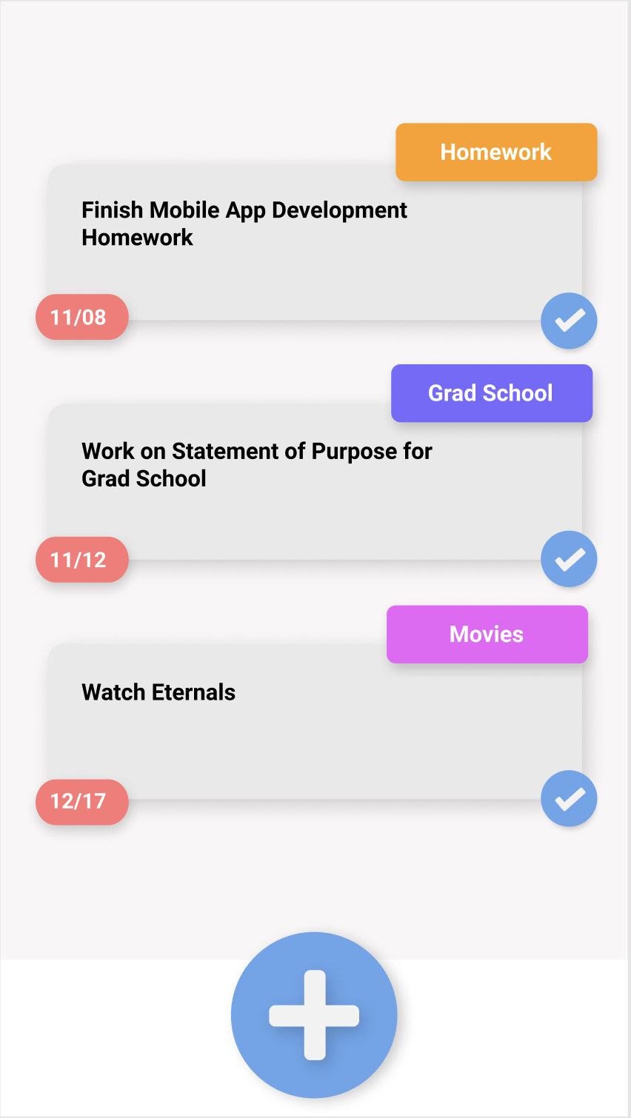
What is Our App?
One of the most important aspects to have a successful college career is setting a good schedule
Combines a to do list with a calendar
Includes a leaderboard to compare number of tasks completed with friends

Slide 4


App Architecture

Slide 5
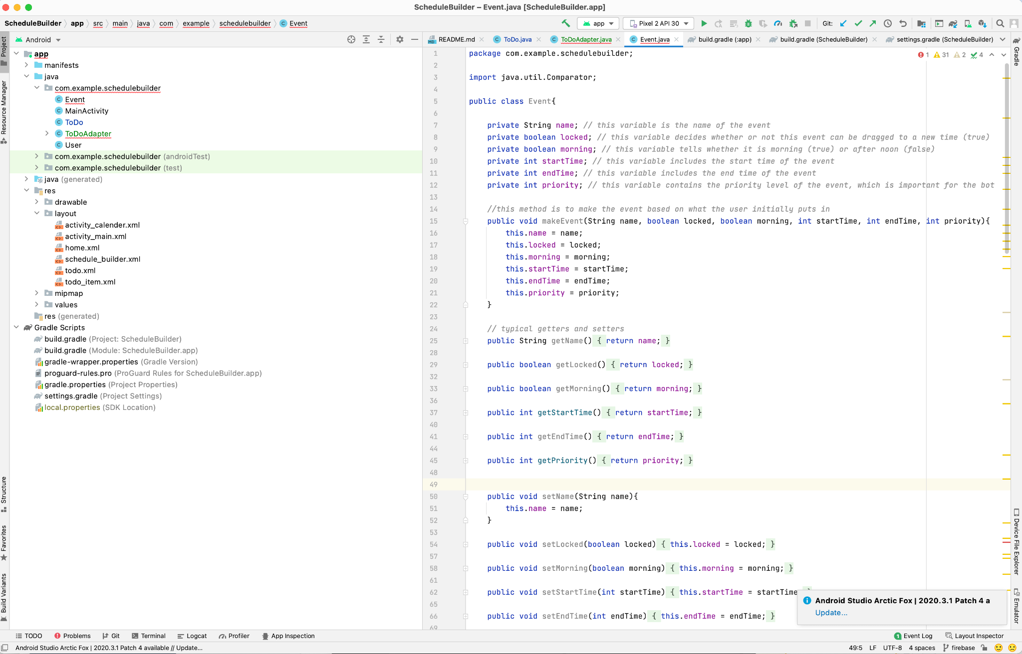
Android

Slide 6
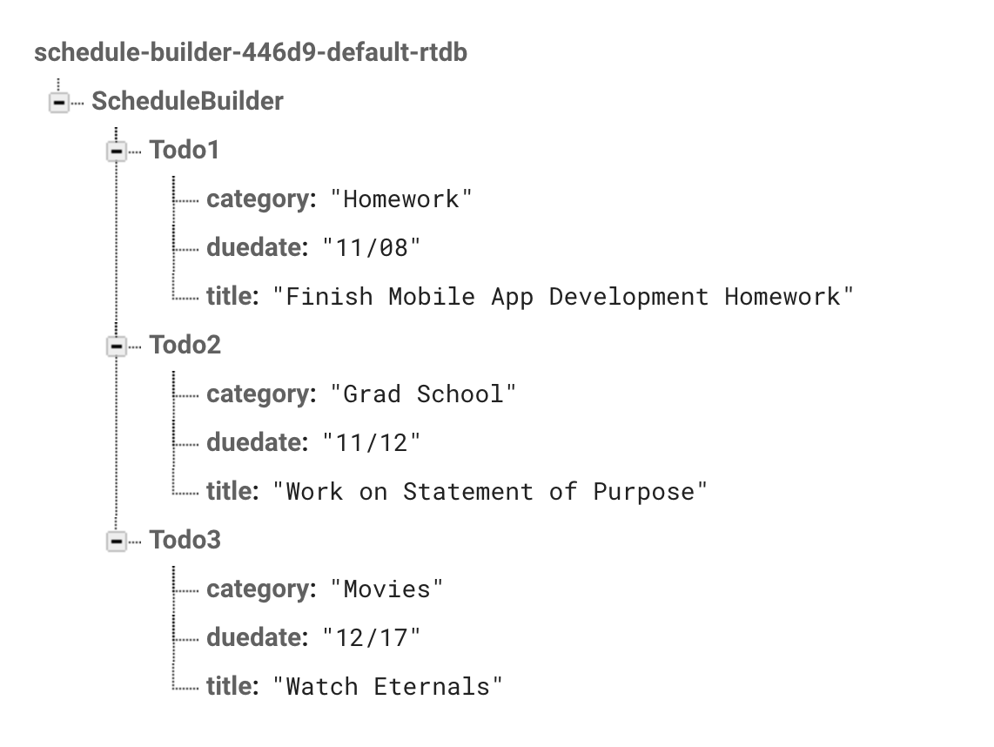
Firebase

Slide 7
Demo

Slide 8
Next Steps
Work on leaderboard
Finish implementing Firebase backend

Slide 9
Thank You!

